Slide 1

Agency
What is the role of the organism in evolution?
(ongoing thinking)

Slide 2
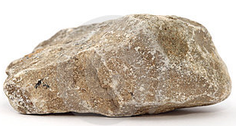
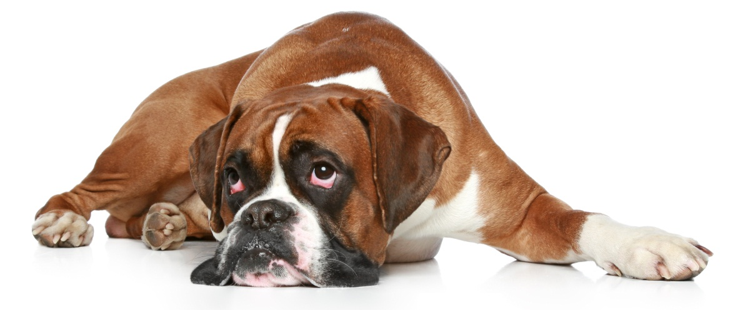
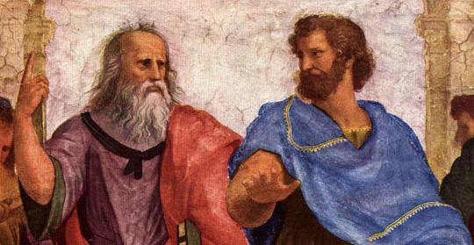
How can we understand what it is to be an animal?
What is the role of the organism in evolution?

Slide 3
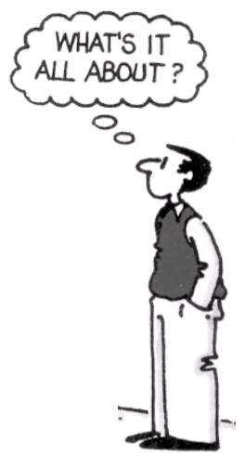
Aristotle (300 BC) acknowledged four types of causes: the material, formal, efficient and final cause (= the purpose), which he called telos.
Aristotle observed that a rock only moves by external forces, while an animal is self-motivated.
Thus, he concluded that animals have telos, which gives them agency driven by internal purposes.
Aristotle did NOT wonder how purpose came into the world, as he lived on “Mother Earth” and saw the natural world as purposeful: it rains because the soil needs water.
How can we understand what it is to be an animal?
Telos!

Slide 4
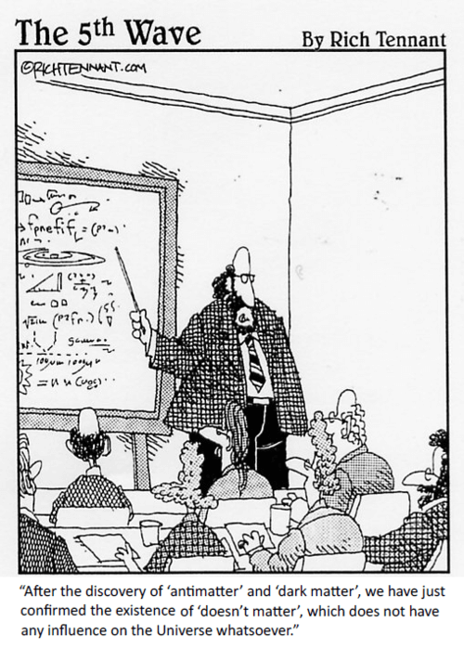
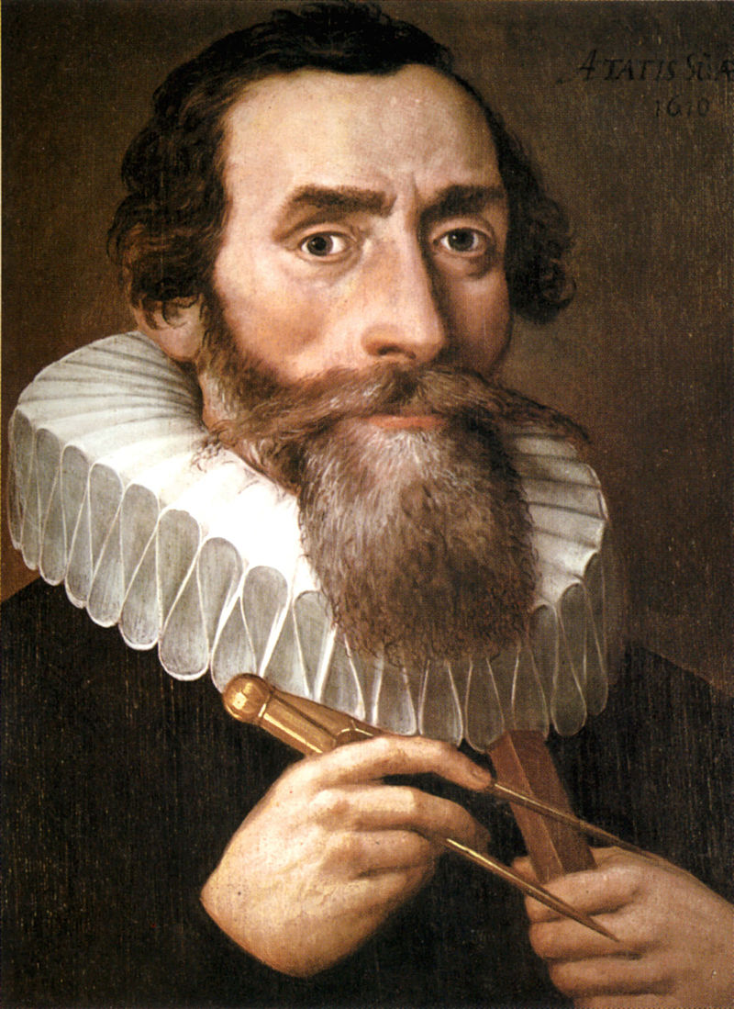
In an inanimate universe, there are causes and consequences, but “nothing matters”: No purpose.
Before life, all matter in the universe was of the form “doesn’t matter”.
Johannes Kepler (1619): I calculate that the solar system is like a mechanical clockwork: no telos needed. There is no Mother Earth: it is a machinery.

Slide 5
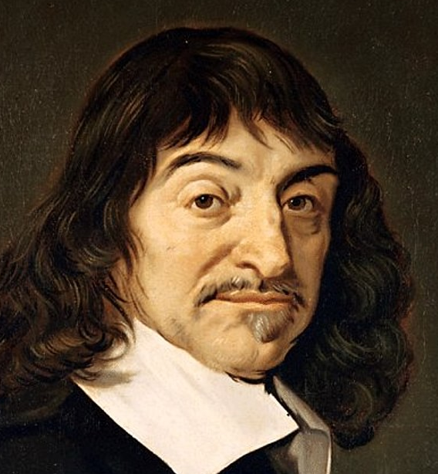
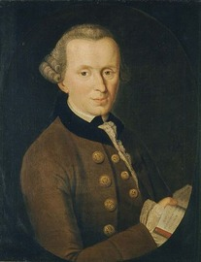
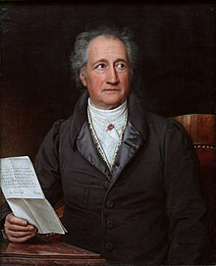
Johannes Kepler (1619): I calculate that the solar system is like a mechanical clockwork: no telos needed. There is no Mother Earth: it is a machinery.
René Descartes (1637): I deduce (from astronomy and the Genesis account) that animals must be machines. Telos only in humans.
Immanuel Kant (1783): I observe that both plants and animals are purposive.
Johan Wolfgang von Goethe (ca 1800): “the moving spirit of the drama of evolution is the organism”.

Slide 6
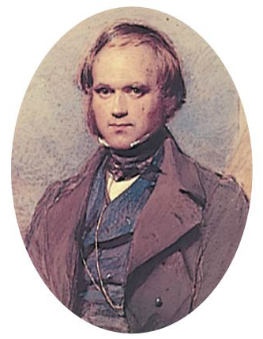
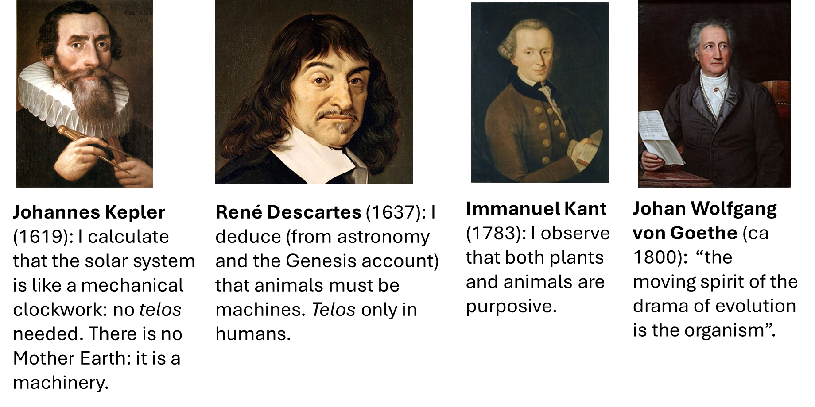

Charles Darwin (1859): Purposiveness in life comes from inheritance and natural selection.
The heritable factors
The organism

Slide 7
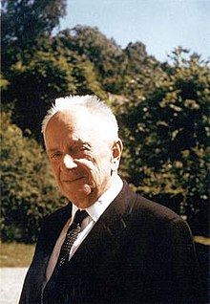
How can we understand what it is to be an organism?
Nothing in biology makes sense except in the light of evolution.
Theodosius Dobzhansky (1900-1975),
Russian-American evolutionary biologist

Slide 8
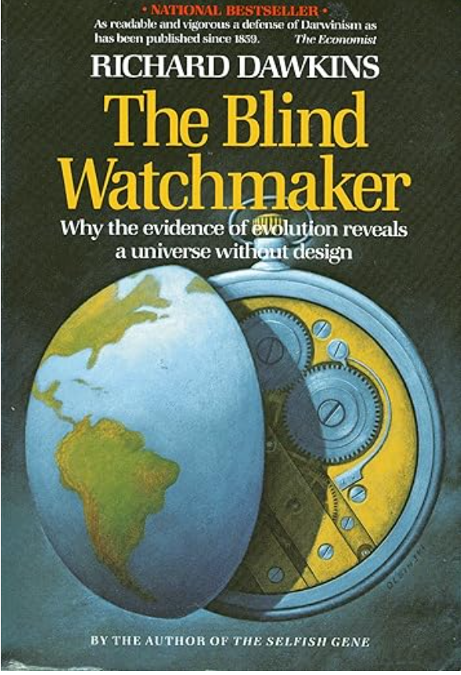
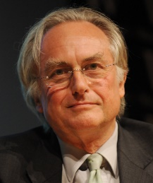
How can we understand what it is to be an organism?
We are survival machines, robot vehicles blindly programmed to preserve the selfish molecules known as genes. This is a truth which still fills me with astonishment.
— Richard Dawkins
From Preface to The Selfish Gene (1976, 2006), p. xxi.

Slide 9
Quite many excellent thinkers are offended by this statement.
A programmed robot vehicle may sound like a passive receiver of commands.
But Dawkins did not mean this: The Selfish Gene describes through many chapters very dynamic and “calculating” agents.
How can we understand what it is to be an organism?
"We are survival machines, robot vehicles blindly programmed to preserve the selfish molecules known as genes. This is a truth which still fills me with astonishment."
— Richard Dawkins
From Preface to The Selfish Gene (1976, 2006), xxi.
trade-off and optimization
kin selection and cooperation
parent-offspring conflicts
evolutionarily stable strategies
life history theory

Slide 10
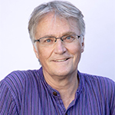
Aristotle, Kant and Goethe are back: Denis Walsh and the purposefulness of the organism
Kant:
I observe that both plants and animals are purposive.
In recent years, some authors again place organismic agency center stage in evolution.
This organism-centered view is often portrayed as
a new idea to replace the gene-centered view in neo-Darwinism and the Modern Synthesis,
or even as Darwin’s own view (Noble 2017; Walsh 2015),
while it can also be seen as a resurgence of Goethe and the Romantics.
Goethe: “the moving spirit of the drama of evolution is the organism”.
Fulda, F. C. 2023. Agential autonomy and biological individuality. Evolution & Development 25:353-370.
Moczek, A. P., S. Sultan, S. Foster, C. Ledon-Rettig, I. Dworkin, H. F. Nijhout, E. Abouheif et al. 2011. The role of developmental plasticity in evolutionary innovation. Proc R Soc B-Biological Sciences 278:2705-2713.
Nadolski, E. M., and A. P. Moczek. 2023. Promises and limits of an agency perspective in evolutionary developmental biology. Evolution & Development 25:371-392.
Noble, D. 2017, Dance to the tune of life: Biological relativity, Cambridge University Press
Rosslenbroich, B. 2024. Evolutionary changes in the capacity for organismic autonomy. J Physiol-Lond. 602:2455-2468.
Shapiro, J. A. 2023. Engines of innovation: biological origins of genome evolution. Biol J Linnean Society 139:441-456.
Sultan, S. E., A. P. Moczek, and D. Walsh. 2022. Bridging the explanatory gaps: What can we learn from a biological agency perspective? Bioessays 44.
Walsh, D. M. 2015, Organisms, agency, and evolution, Cambridge University Press.
Walsh, D. M 2018. Objectcy and agency: Towards a methodological vitalism, Pages 167-185 in D. J. Nicholson, and J. Dupré, eds. Everything flows, Oxford University Press.

Slide 11
Aristotle, Kant and Goethe are back: Denis Walsh and the purposefulness of the organism
Vitalism!
Kant:
I observe that both plants and animals are purposive.
They argue that organisms are natural purposive agents that actively engage with their environments,
that organismic agential adaptation and not natural selection drives evolutionary change,
and further that organismic purposiveness explains their own development,
and from this that evolution is the consequence of the organisms’ pursuit of their own goals.
Goethe: “the moving spirit of the drama of evolution is the organism”.
Walsh, D. M., and G. Rupik. 2023. The agential perspective: Countermapping the modern synthesis. Evolution & Development 25:335-352.

Slide 12
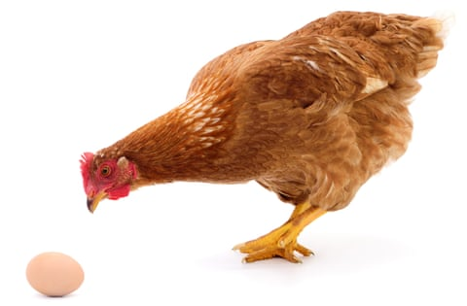
Evolution by genes or organisms?
Walsh and others therefore claim that Dawkins’ replicator/vehicle metaphor is wrong: organisms are the fundamental evolutionary agents.
Is this a chicken and egg question? Or does one drive the other?
Is is possible (useful) to separate the organism from its genes?
Is evolution better explained by the organism than by the genes?
A chicken and egg problem?

Slide 13
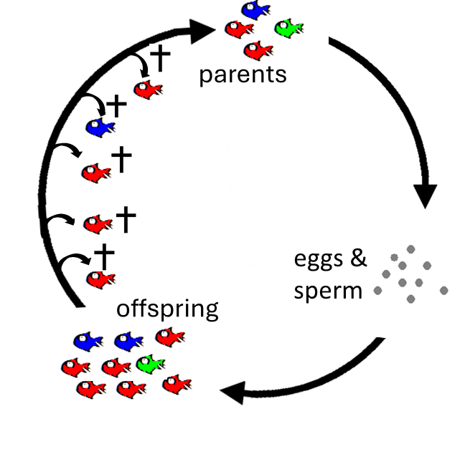
Evolution by natural selection or genetic drift happened whenever the parents were a genetically non-random subset of the newborns in each past generation.
The development of a vertebrate animal’s body is basically a roll-out orchestrated by 500 million years old Hox genes (39 in mammals, 47 in teleosts),
while the agentic capacities of some vertebrates also depend on social learning and parental care.
In the start of every multicellular life, the organism is only a zygote with genes, some molecules, and 1 cell from the mother.

Slide 14
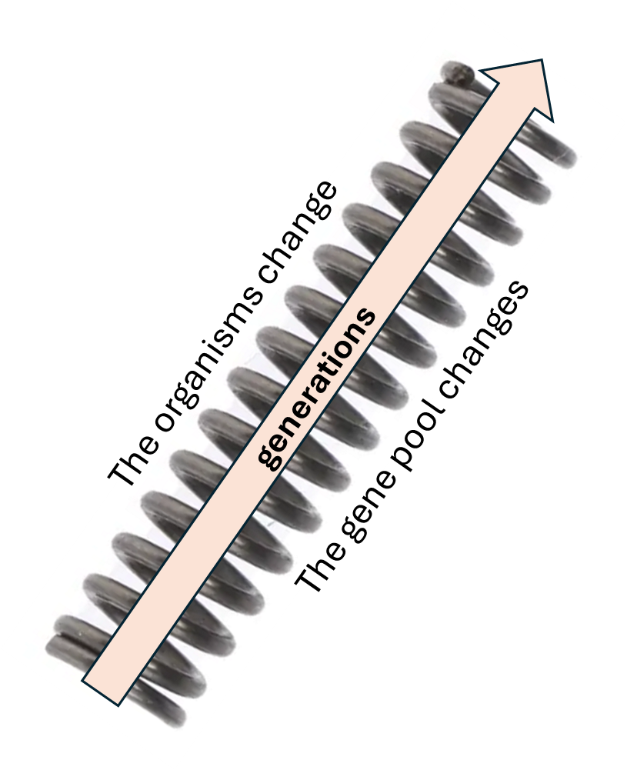
Is is possible (useful) to separate the organism from its genes?
Is evolution better explained by the organism than by the genes?
One cannot understand the gene pool except from the non-random reproduction of organisms in previous generations.
One cannot understand the ephemeral organism except through the past evolution of its genes.
A chicken and egg problem?
No, not really.

Slide 15
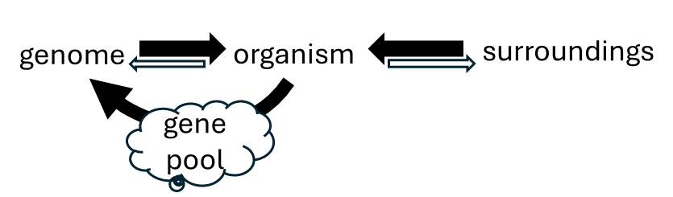
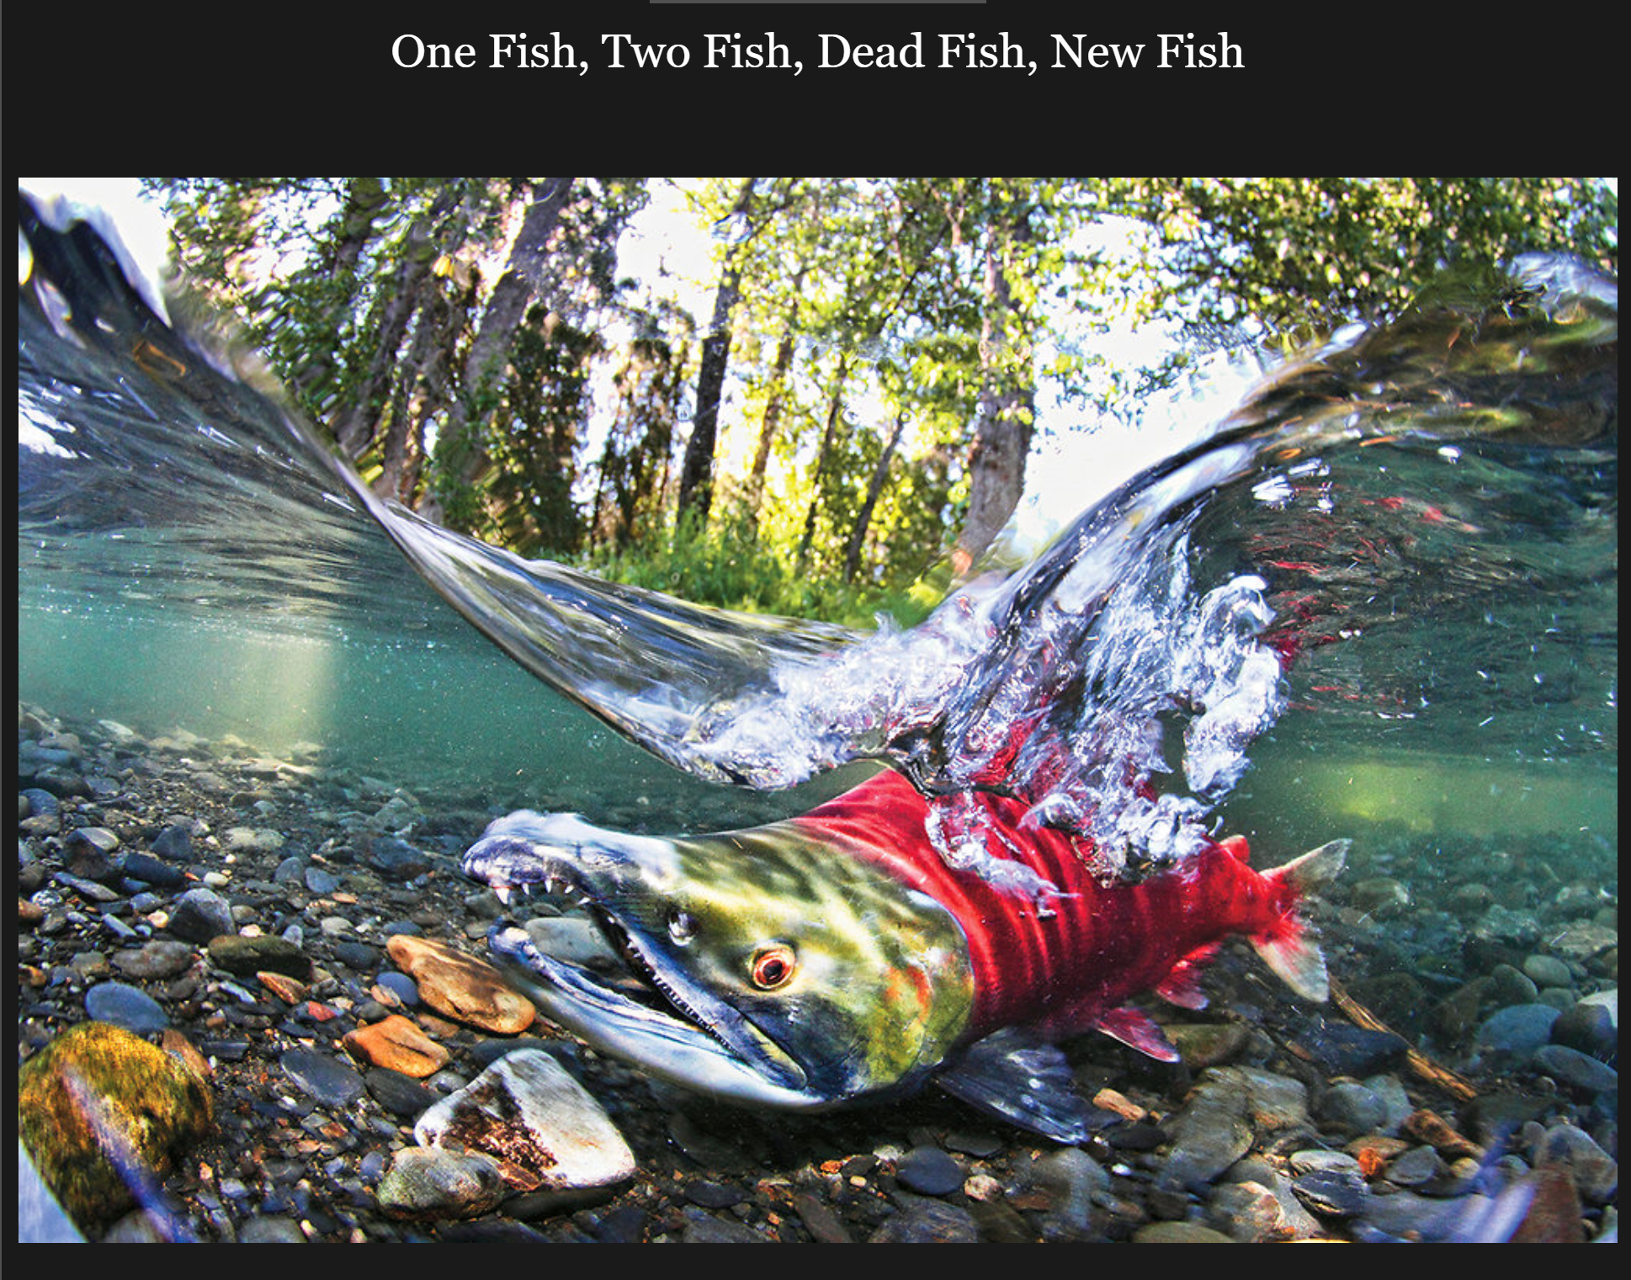
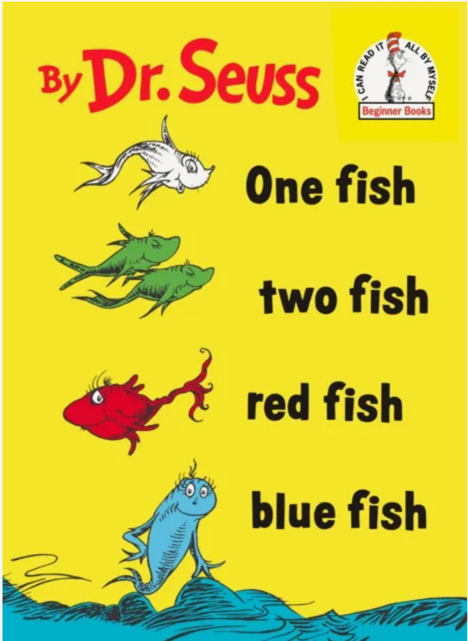
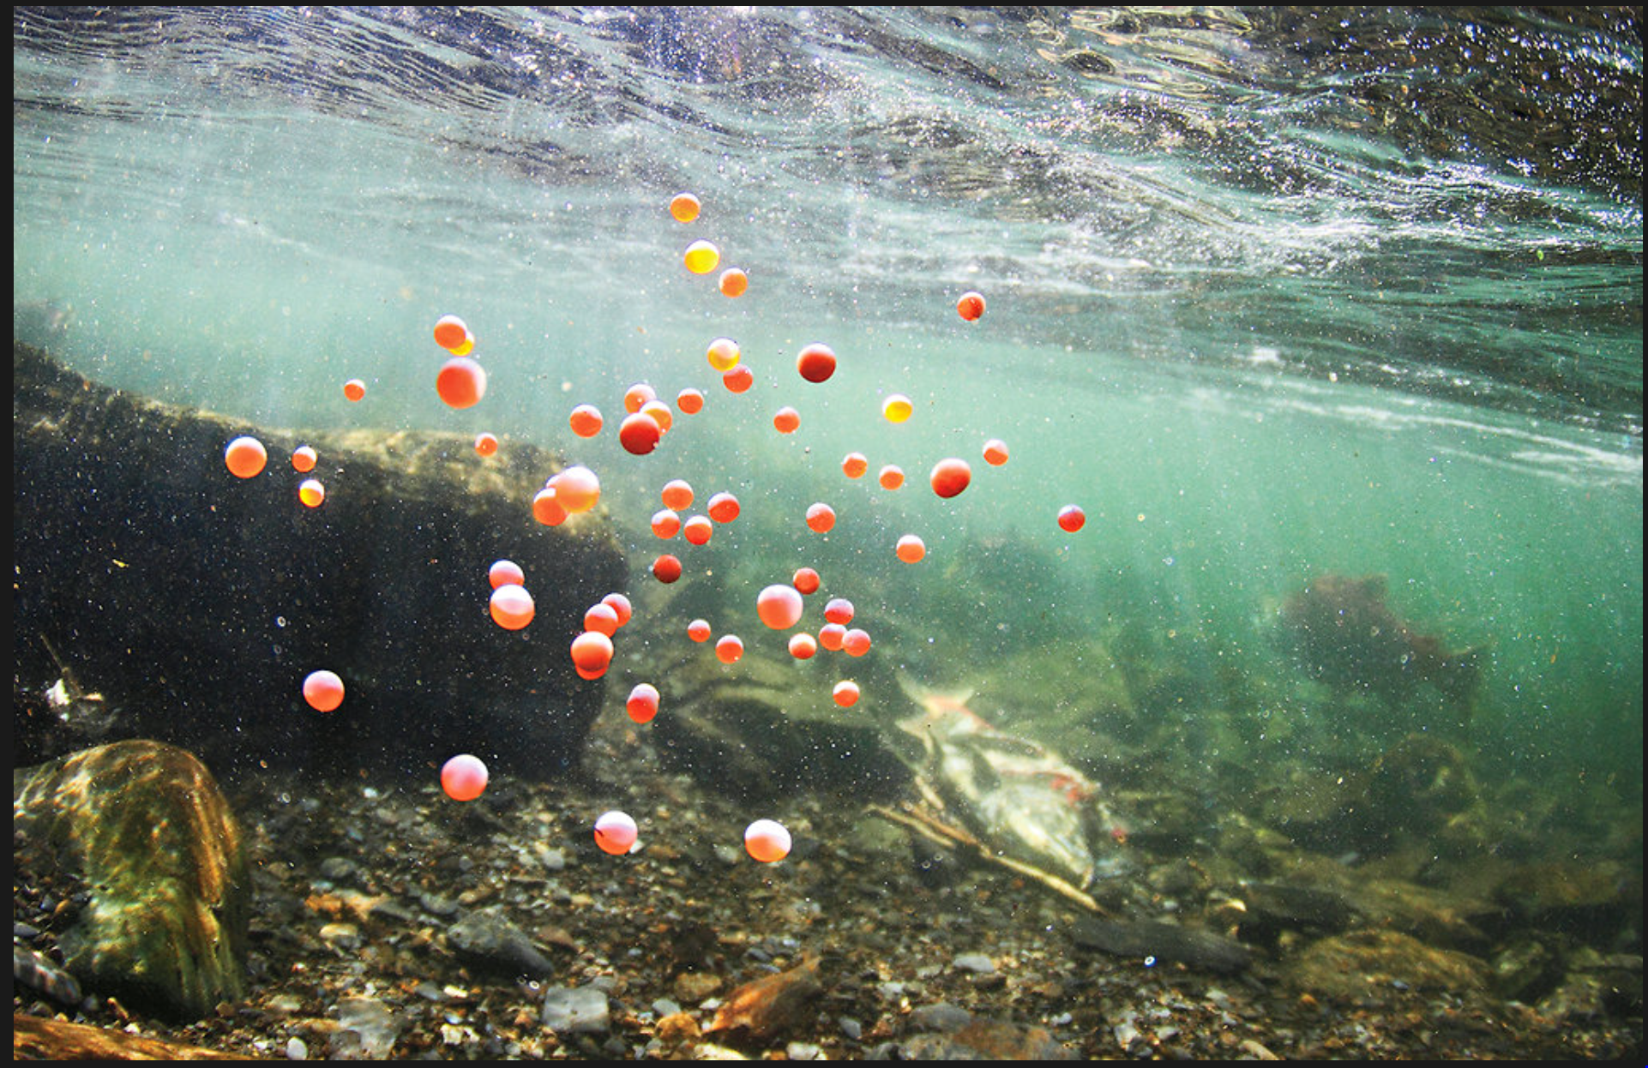
Evolution by genes or organisms?
Here is a clue: Organisms perish for the sake of reproduction.
This is life history theory, established by Lotka in 1925.
The Disposable Soma Theory.
Other clues:
Sexual reproduction (offspring gets half your genes, half from someone else, often a stranger)
Conflicts between genes (also cooperation, cheating, selfish genetic elements)
Kin selection (forego own reproduction to help relatives)

Slide 16

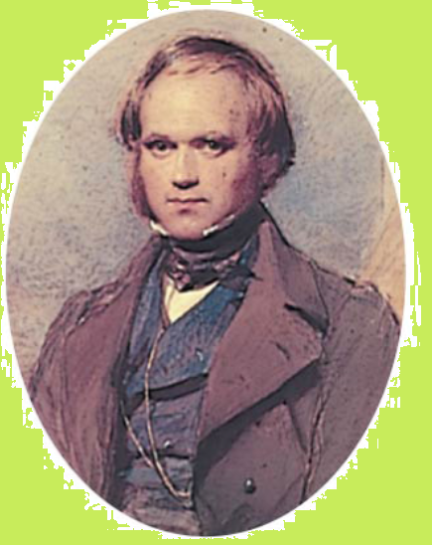

“Dawkins and I” mean to say (what life-history theory, kin selection and much more tell us) that biological organisms are agents of the James Bond type: on behalf of our replicators.
All agentic capacities
in biological
organisms have
evolved by mutations
and natural selection.
However, this selection is between organisms.
Agent on behalf of MI6

Slide 17
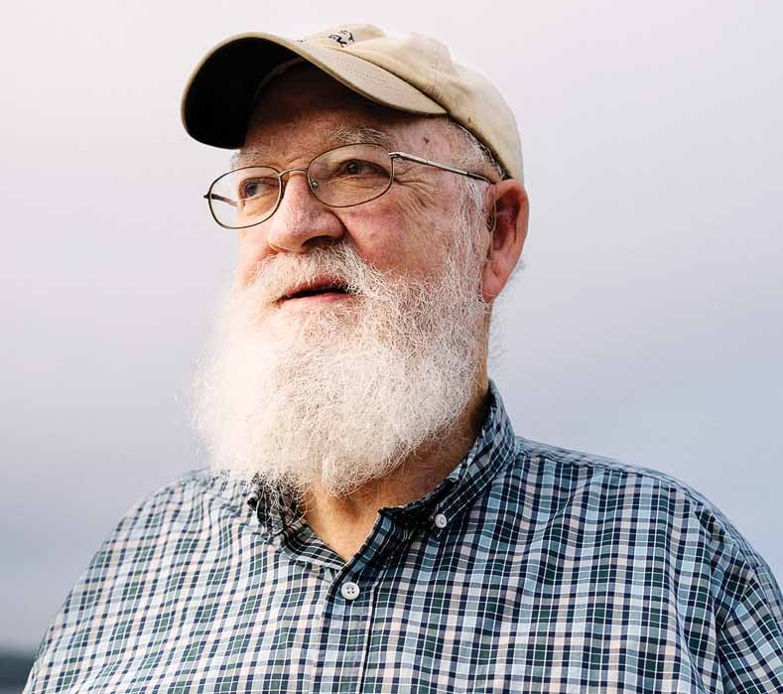
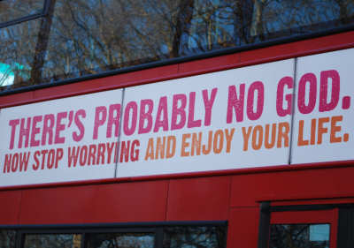
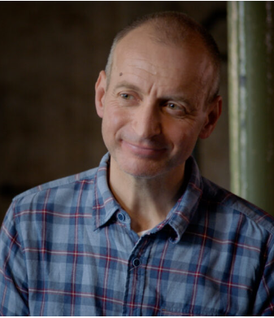
Okasha (2024): “As if” agency
Daniel Dennett argued that organisms appear as if they were designed by an intelligence, but natural selection is an unconscious, mindless process.
This aligns with Richard Dawkins' Blind Watchmaker: there seems to have been a designer, but there probably isn’t one.
Samir Okasha argues that all living organisms are “as if” agents on behalf of the genes. (He comes to Bergen next spring.)
Dawkins, R. 1986, The blind watchmaker, Norton & Company.
Dennett, DC. 1995. Darwin’s Dangerous Idea: Evolution and the Meanings of Life. Simon & Schuster.
Okasha, S. 2024. The concept of agent in biology: Motivations and meanings. Biological Theory 19:6-10

Slide 18
It is the economy , stupid!
It is the algorithm, stupid!
Bodies, phenotypes, are not coded for by genes.
There is no gene combination for my body mass.
But there are gene combinations for the strategies a body use to gain weight.
The agentic profile of the organism is defined by the architectures and strategies that the genes in concerts code for: the algorithms.

Slide 19
Summary statement
How can we understand what it is to be an organism?
While remembering “as if” from Dennett and Okasha, we can now come to a tripartite evolutionary account of agency:
(i) The organism is an autonomous agent,
(ii) the genes are replicators and the ultimate source of this agency, and
(iii) the gene-based architectures and algorithmic rules that the organism follows encompass the expression of the agency.
Now, let us follow the unfolding of greater agentic capacities through evolution.

Slide 20
Agency has evolved and diversified
genome
organism
surroundings
gene pool
Some genes that originated by random mutation, have evolved
as they increased the algorithmic capacity and competence of the organism
in making decisions on behavior or development,
leading to more offspring, and thus, more copies of these genes.

Slide 21
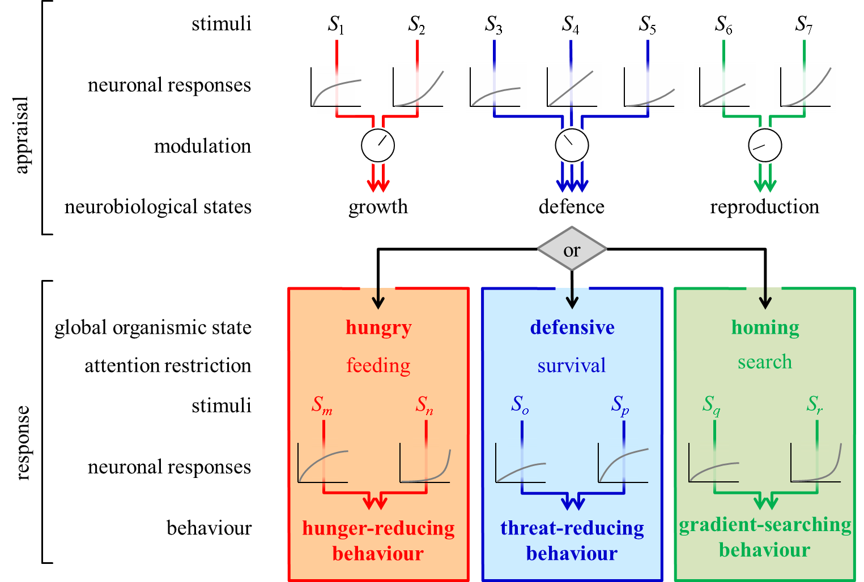
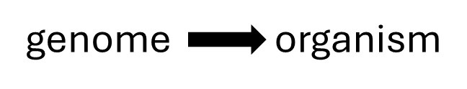
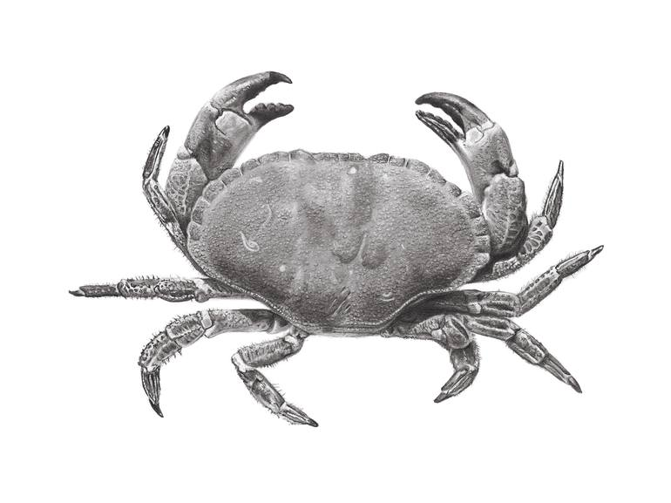
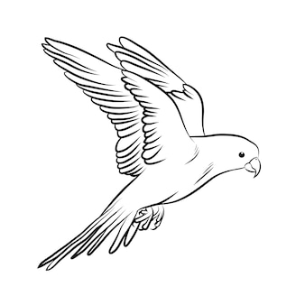
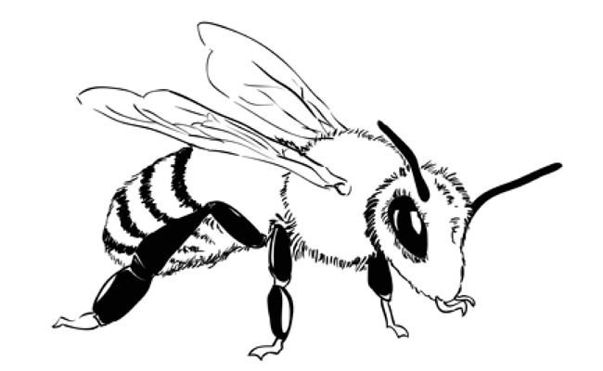
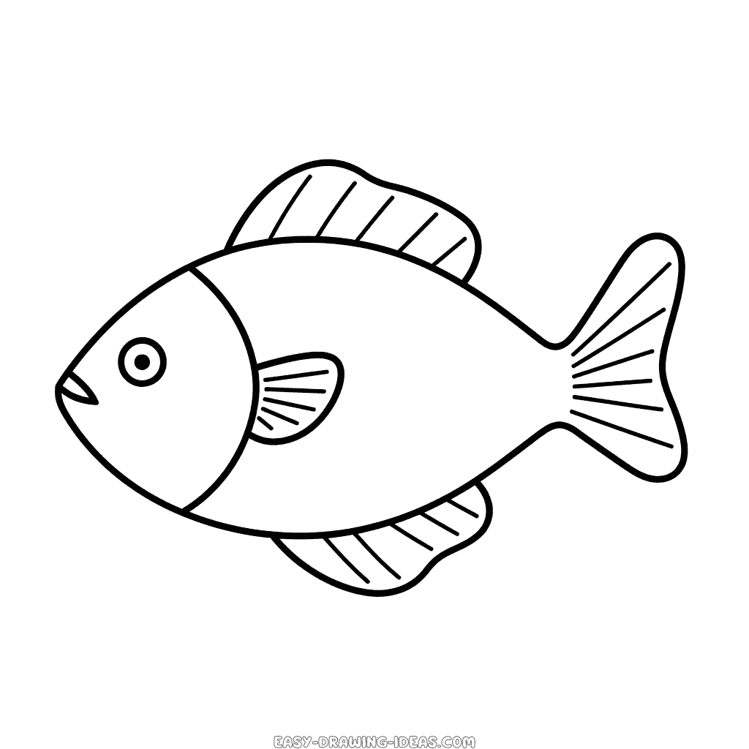
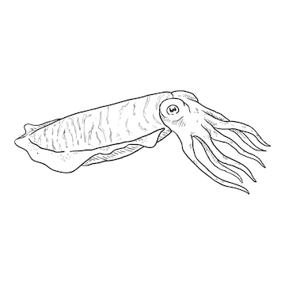
Agency has evolved and diversified
“As if” (Okasha 2024): Agency of the first organisms was rooted in genes
The first cells
Agents who learn
Agents with conflicting emotions
and with unlimited associative learning

Slide 22
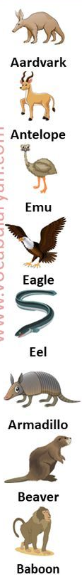
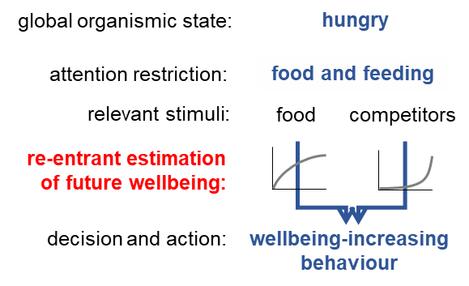
Agency has evolved and diversified
“As if”: Agency of the first organisms was rooted in genes
The first cells
Agents who learn
Agents with conflicting emotions
Agents with imagination

Slide 23
Agents with imagination and simulation
Vertebrates (and some others) have episodic-like memory: information in memory about where/what/when/with whom
Damasio: “The feeling of what happens”
Imagination (prediction) of the emotion that a behavior may result in.

Slide 24
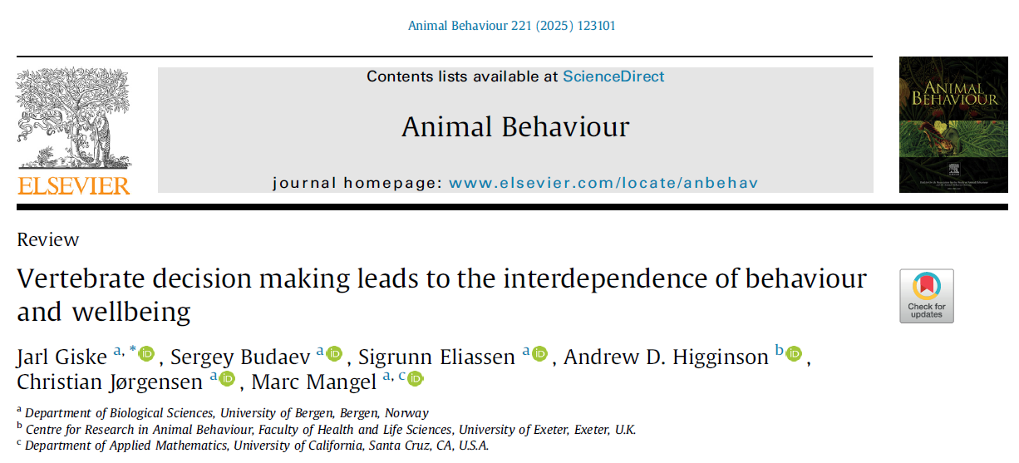
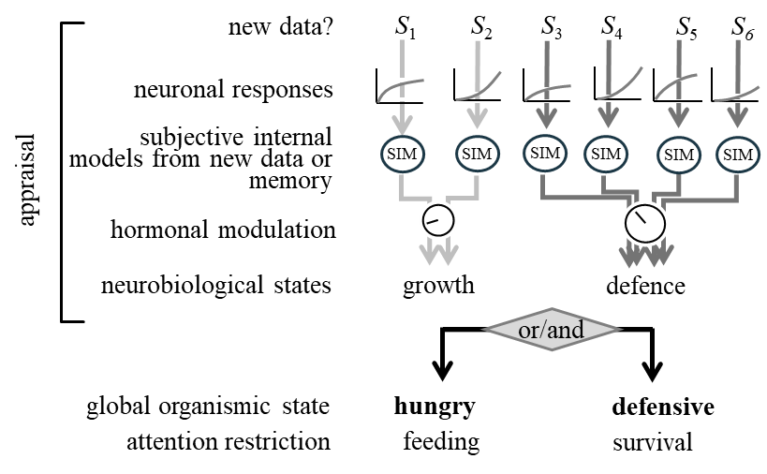
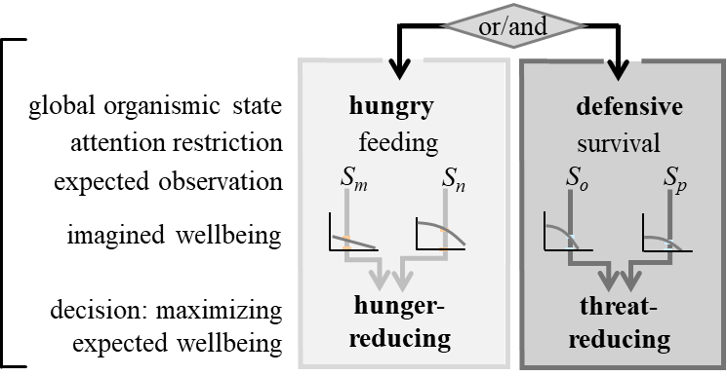
The Hypothesis
We hypothesize that decision making in vertebrates is a two-step common currency mechanism in which the individual
determines its current priority by competition between sensory-derived emotions in the brain, and
chooses its behavior by imagining its expected wellbeing in different scenarios, utilizing episodic-like memory.

Slide 25
The Hypothesis
This means that vertebrates (and others?) are agents that make their decisions to obtain the highest possible (short-term) emotional wellbeing.
We hypothesize that decision making in vertebrates is a two-step common currency mechanism in which the individual
determines its current priority by competition between sensory-derived emotions in the brain, and
chooses its behavior by imagining its expected wellbeing in different scenarios, utilizing episodic-like memory.

Slide 26
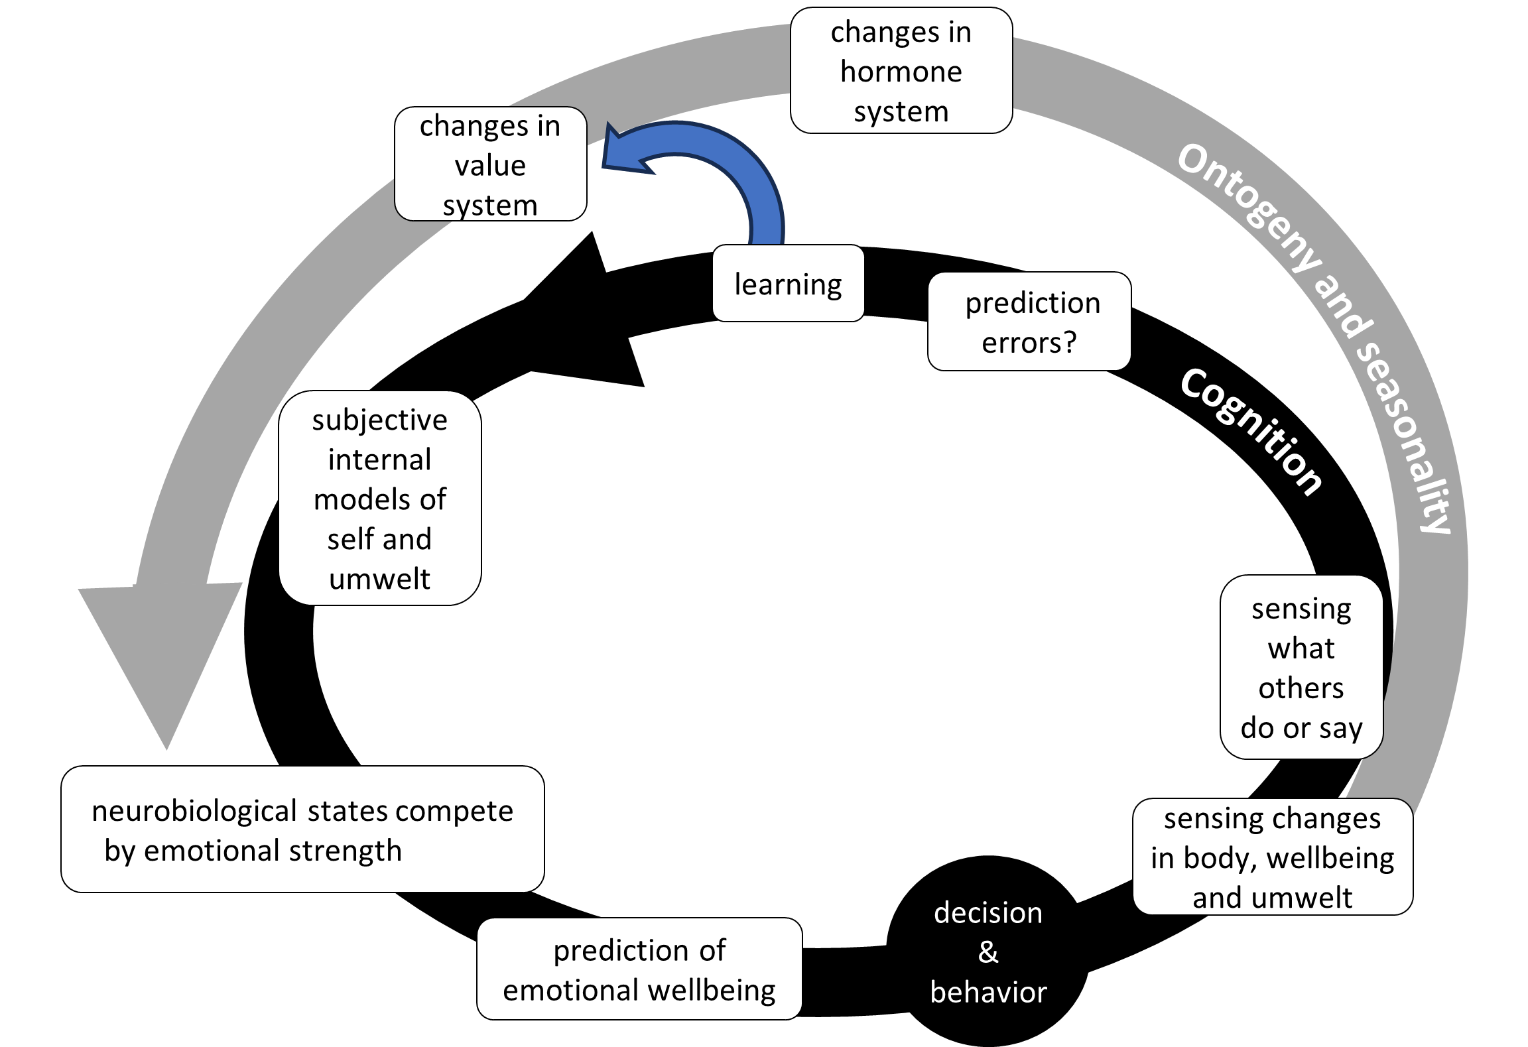
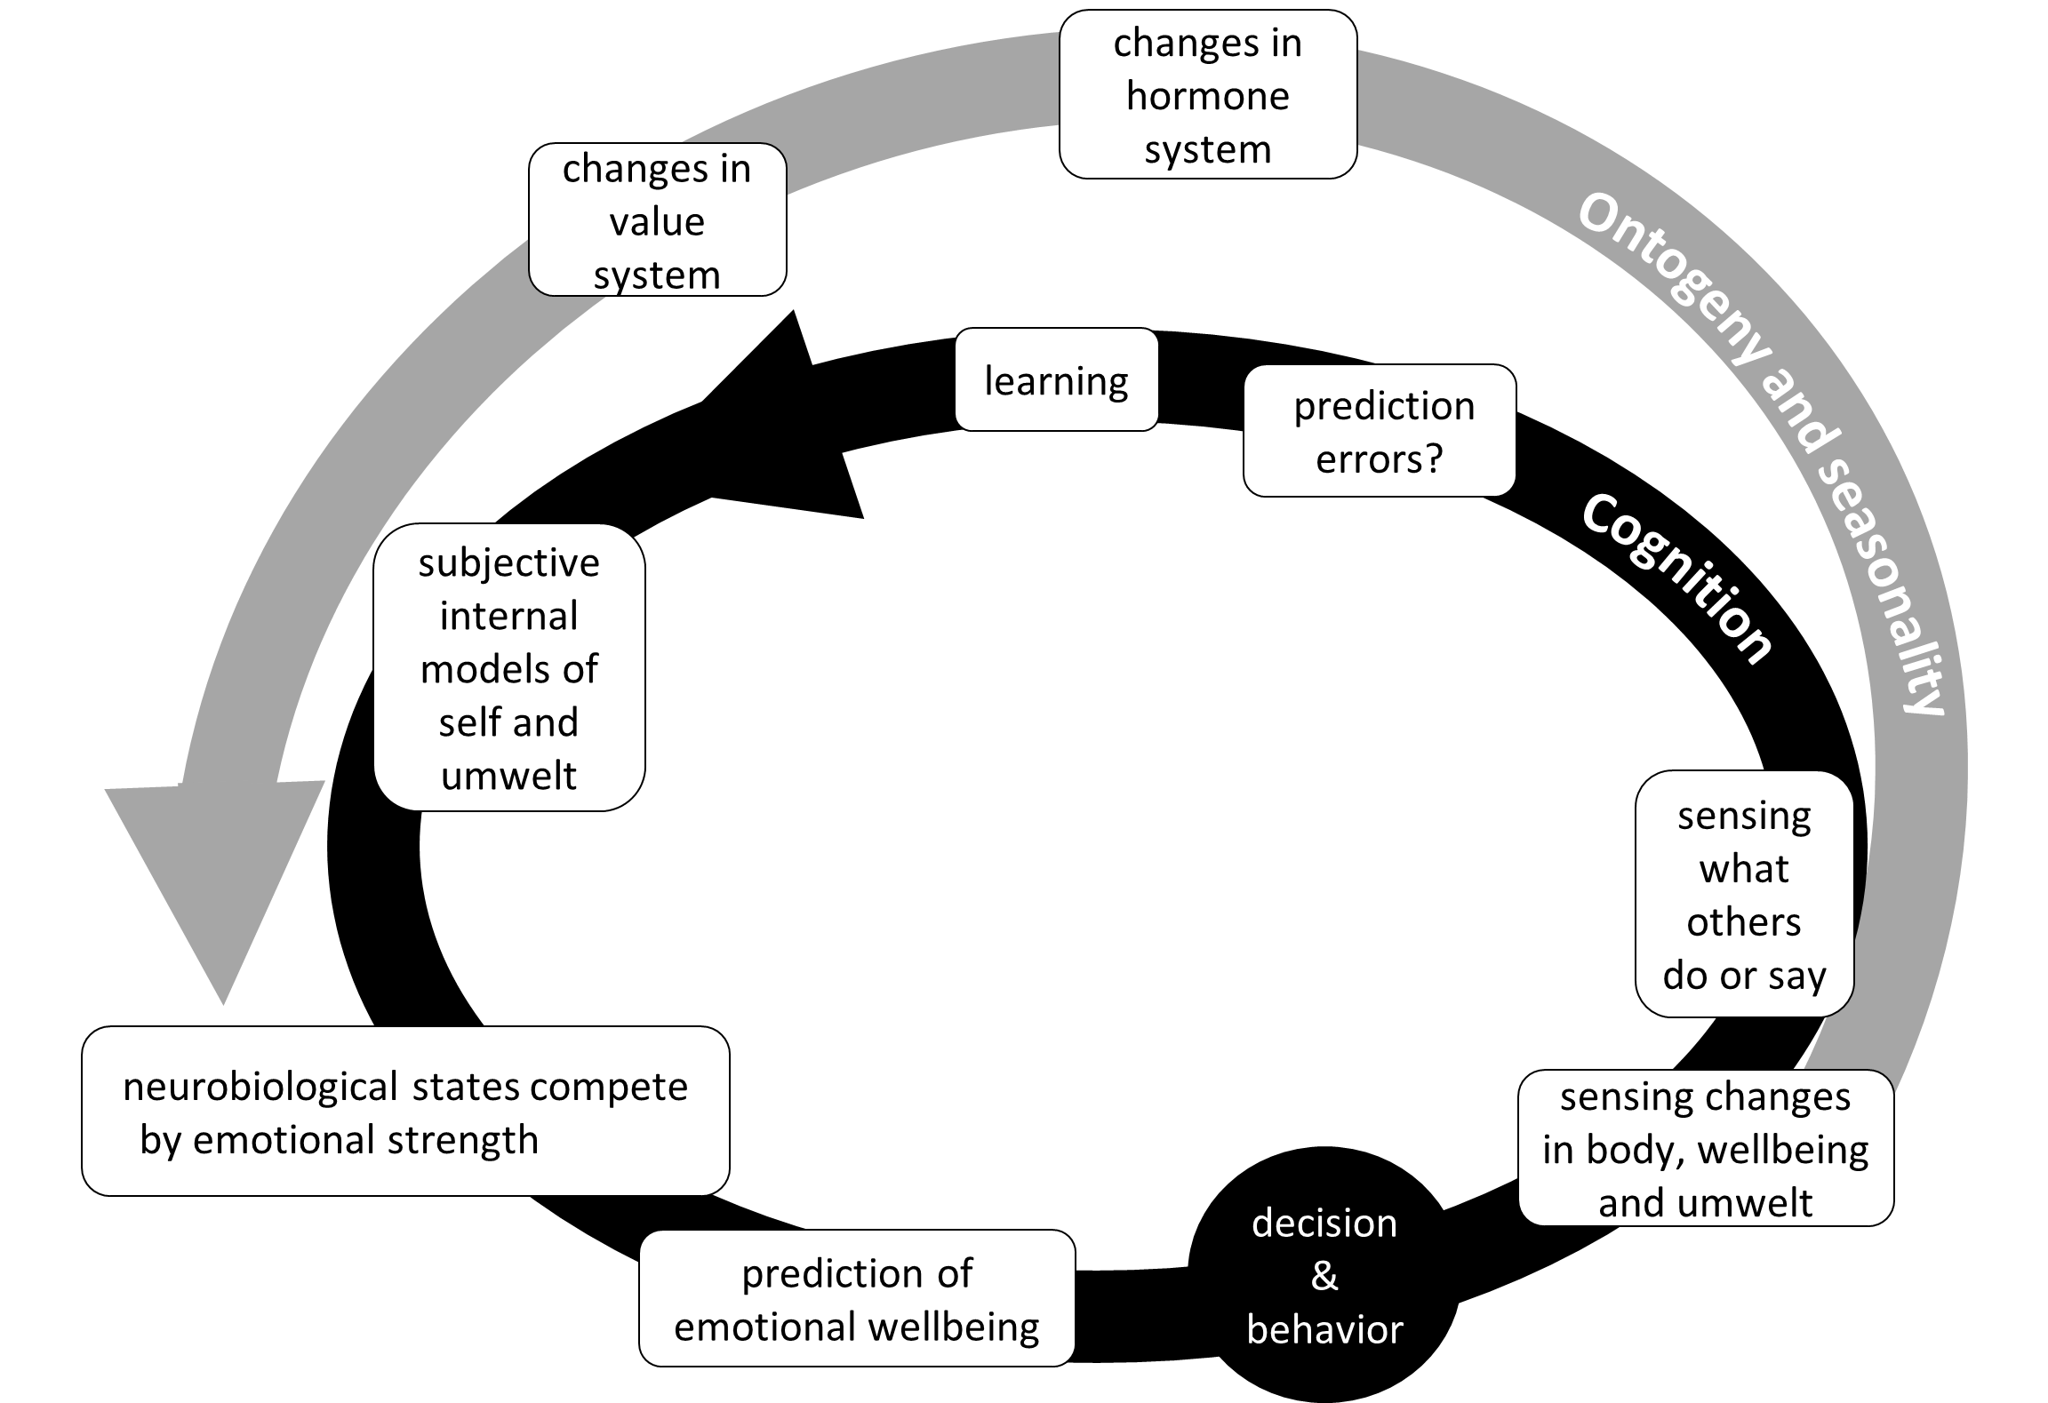
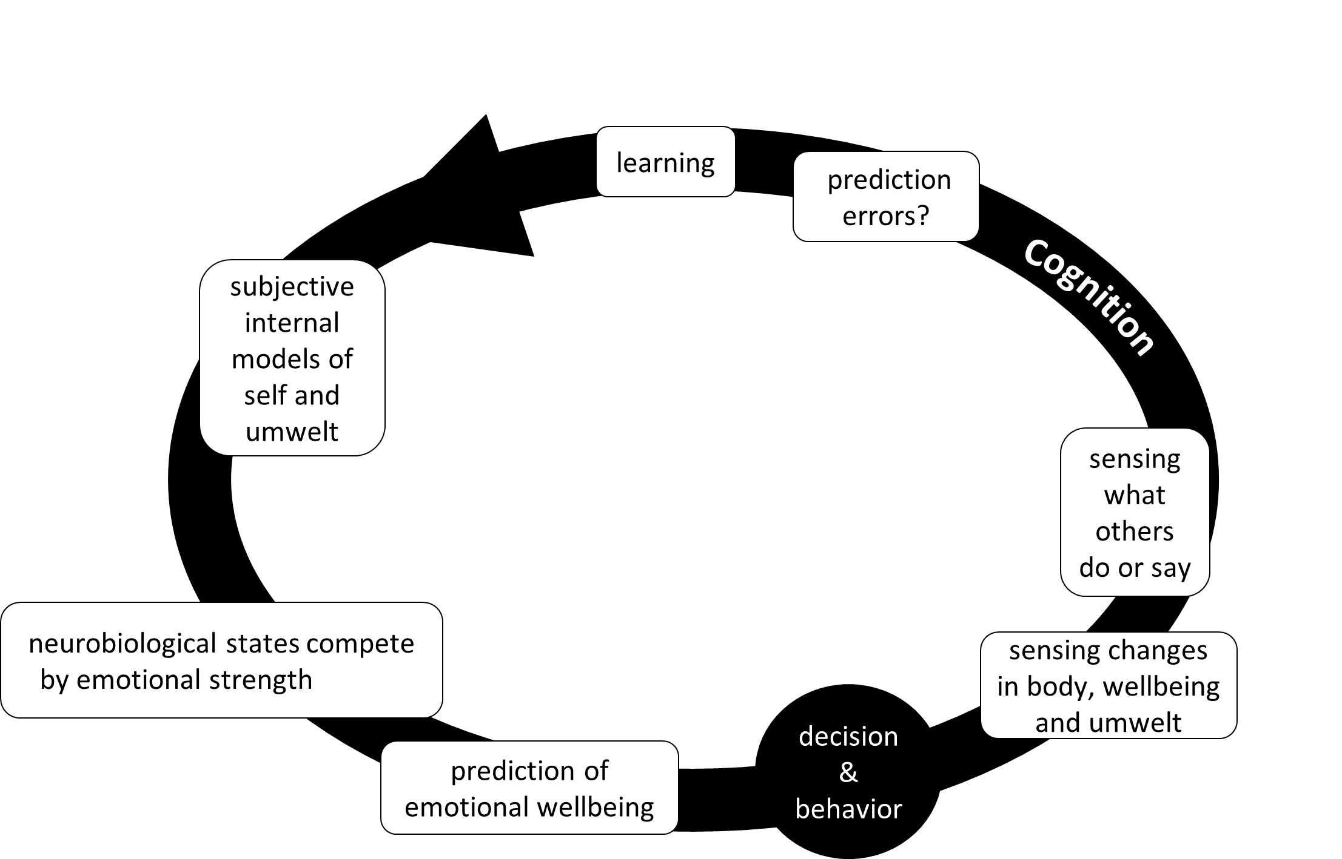
Agency has evolved and diversified
“As if”: Agency of the first organisms was rooted in genes
The first cells
Agents who learn
Agents with conflicting emotions
Agents with imagination
Agents with learned values

Slide 27
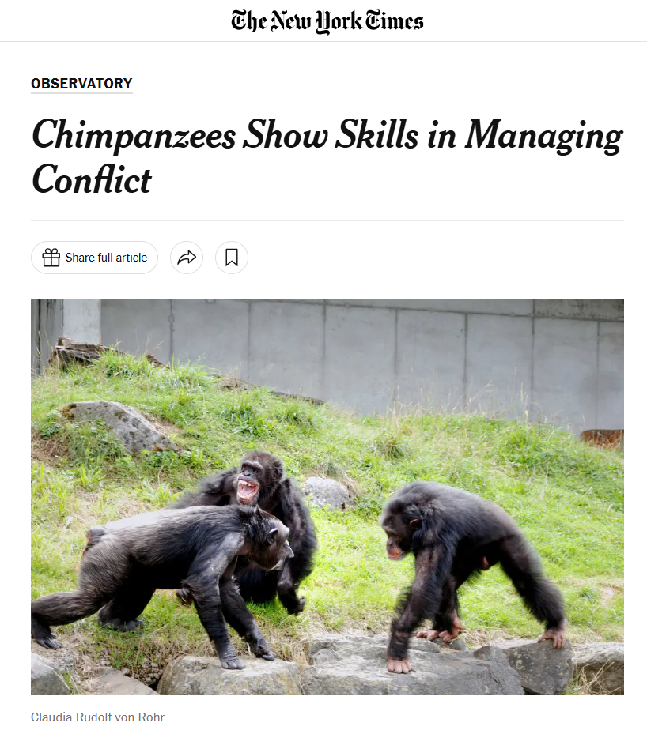
Agency has evolved and diversified
The first cells
Agents who learn
Agents with conflicting emotions
Agents with imagination
Agents with learned values
norms and

Slide 28
The self-domestication hypothesis
We think of this explanation:
Human culture may have tamed human genetics,
because some phenotypes (and their genes) were selected for their ability to live according to culturally transmitted norms and values.
Ultimate natural selection
Proximate mechanisms for wellbeing in vertebrates
Evolution of culture (norms and values) from proximate preferences
Changes in fitness landscape
Ultimate natural selection of genes and culture
Gavrilets, S. 2012. Human origins and the transition from promiscuity to pair-bonding. PNAS 109: 9923-9928.
Hare, B. 2017. Survival of the friendliest: Homo sapiens evolved via selection for prosociality. Annu Rev Psychol 68: 155-186.
Wrangham, R. W. 2018. Two types of aggression in human evolution. PNAS 115: 245-253.

Slide 29
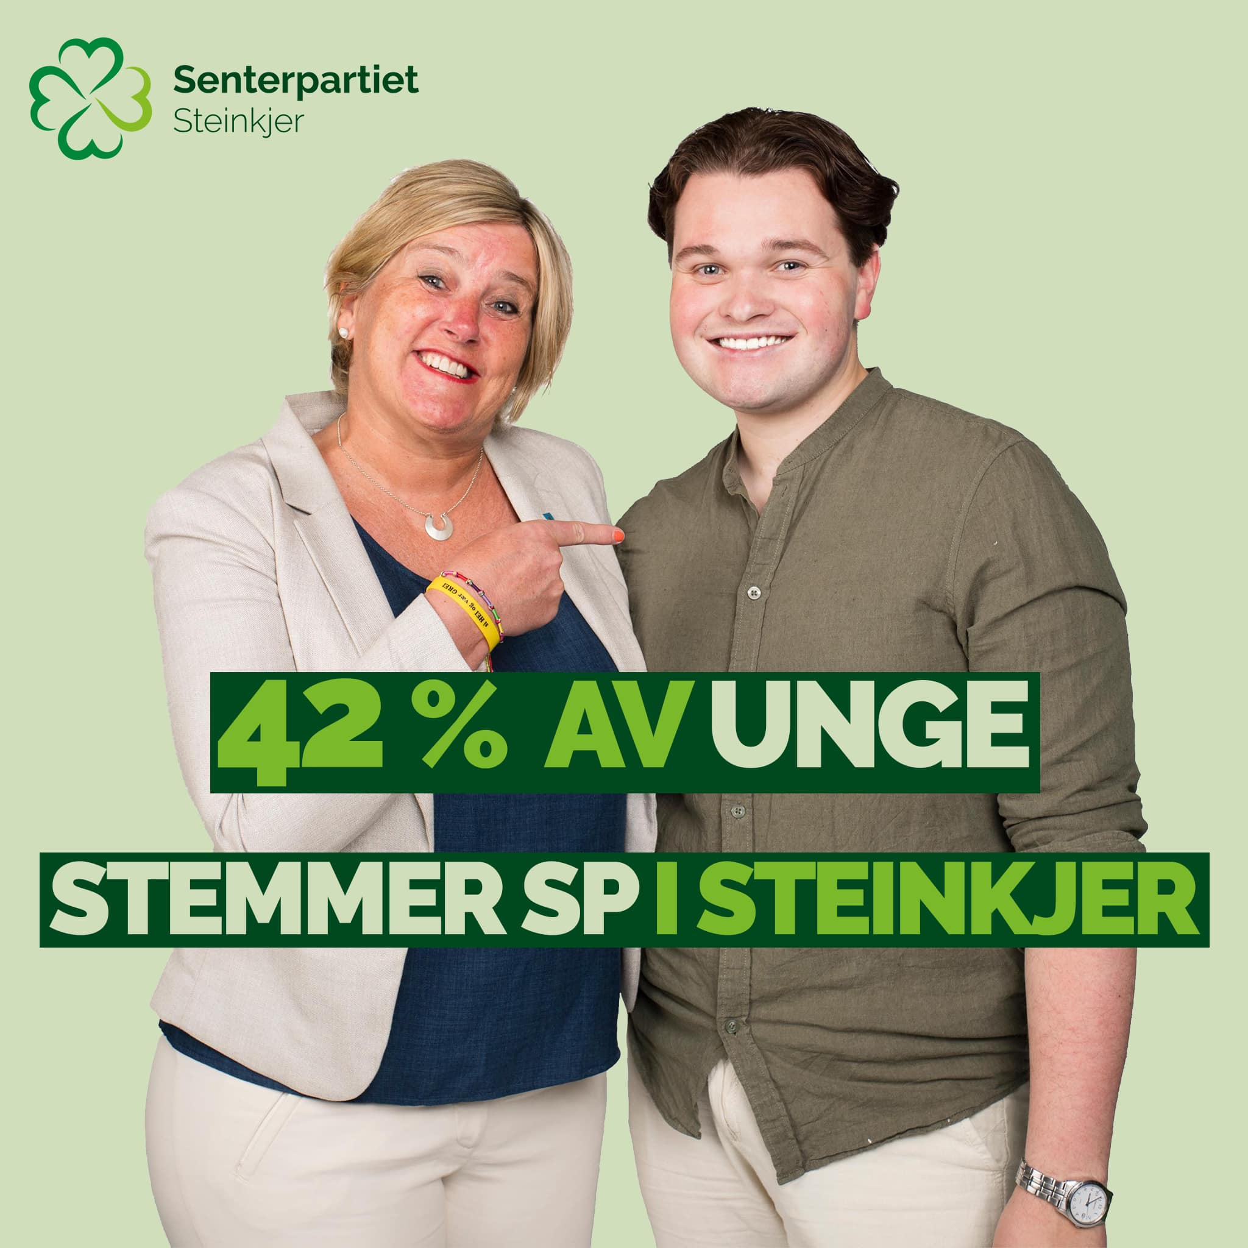

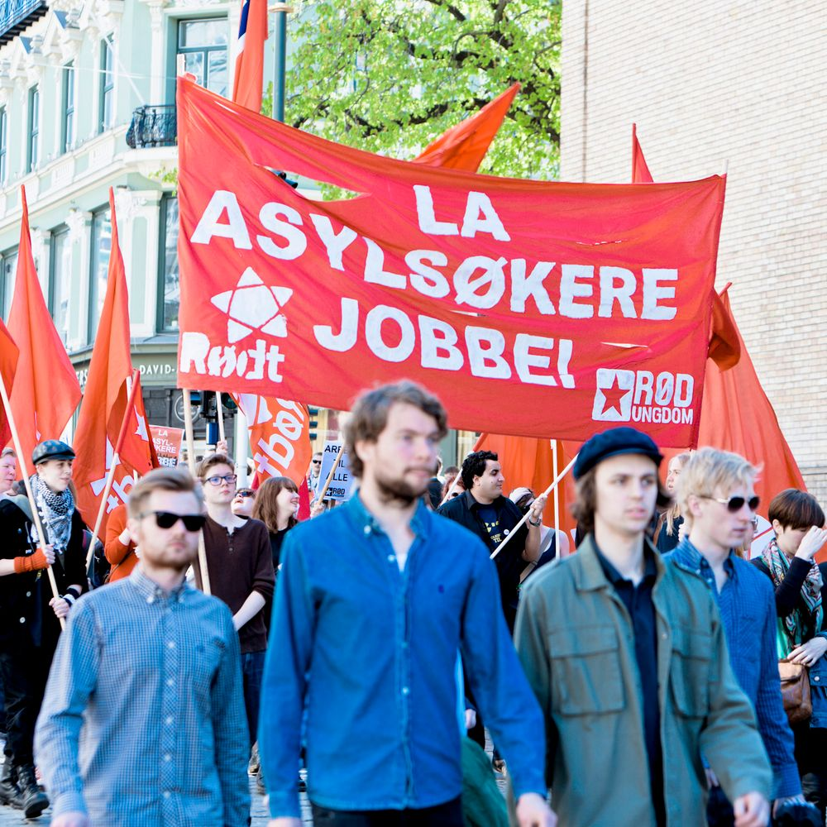
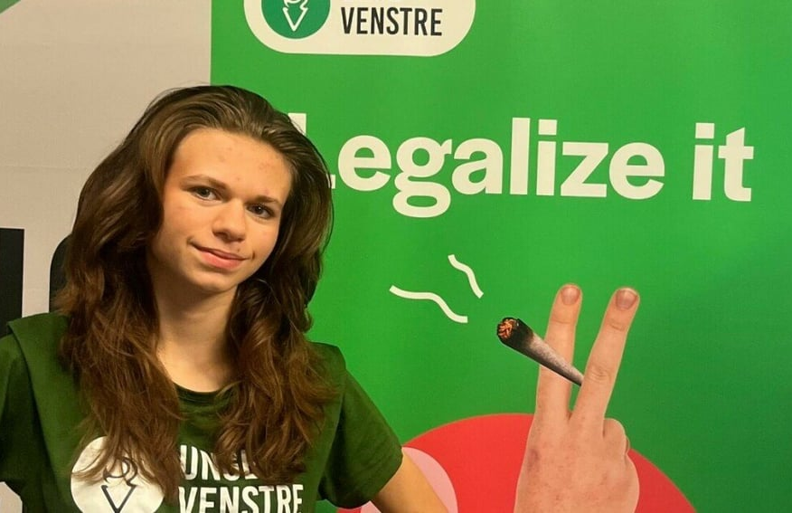

In the modern human society, one does not automatically adopt the norms of one’s peers.
Now, norms and values are available on the global market, and they evolve fast.

Slide 30
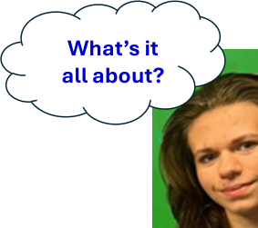
Agency has evolved and diversified
“As if”: Agency of the first organisms was rooted in genes
The first cells
Agents who learn
Agents with conflicting emotions
Agents with imagination
Agents with learned values
Agents with “as if” free will

Slide 31
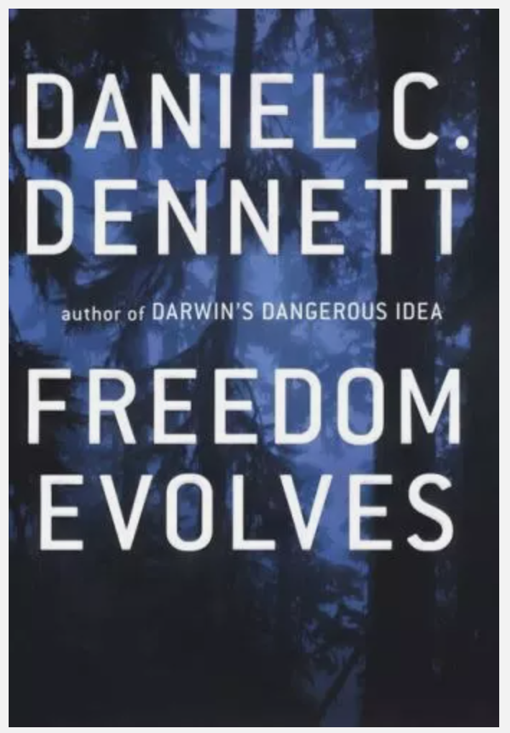
Agents with “as if” free will
learning
Some genes that originated by random mutation, have evolved
as they increased the algorithmic capacity and competence of the organism
in making decisions on behavior or development,
leading to more offspring, and thus, more copies of these genes.
free will
In humans, norms and values are now much more the individual’s own choice. Thus, there is an active role of the individual in deciding its norms and values, but not its genes.
This is as close to free will as evolution has brought any biological agent. For most practical purposes, “as if” free will is close enough (Dennett 2003).

Slide 32
Daniel Dennett (1942-2024)
We act as if we have free will, and that’s all we need.
This is enough for morality, responsibility, and decision making.
Determinism and free will are compatible.
We don’t need total independence from prior causes, just enough flexibility to act meaningfully.
Dennett, DC 1984. Elbow Room: The Varieties of Free Will Worth Wanting. MIT Press.
Dennett, DC 2003. Freedom Evolves. Viking Press.
Dennett, DC 2015. Varieties of free will worth wanting, in The Oxford Handbook of Free Will (2nd ed.).

Slide 33
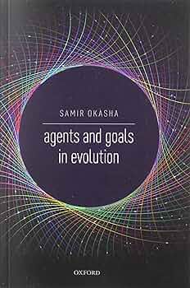
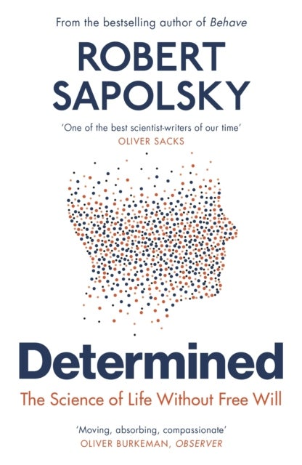
Agents with “as if” free will
For most practical purposes, “as if” free will is close enough (Dennett 2003).
Sapolsky (2023) argues that all organismic agency is non-existent, due to the ultimately total control of genes and culture.
We think this is too far. Both “as if” agency (Okasha 2024) and “as if” free will are important factors in genetic and cultural evolution.

Slide 34
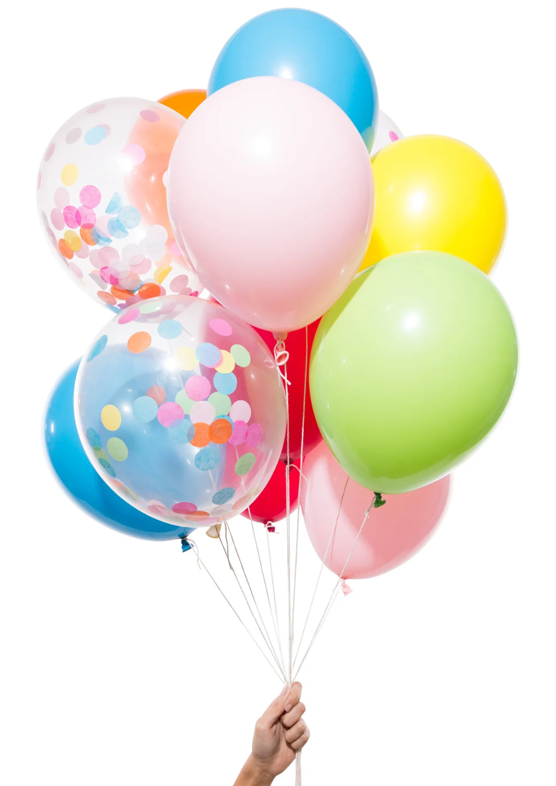
Actually, we mean that the evolutionary emergence of “as if” free will on a planet is worth a celebration.
It is a great feat of the blind watchmaker.
It started with replicators, who are the ultimate causes for organisms.

